Slide 1
2Sigma’s Interest in Rental Listings
The Morning Owls: Stephanie, Amit, Boris

Slide 2
Business Summary
Kaggle: https://www.kaggle.com/c/two-sigma-connect-rental-listing-inquiries Use rental listing features to predict interest in rental inquiries.
Notebook: https://github.com/letslego/Rentop/
Problem: First, it is to provide feedback to owners and agents on how to optimize listings to generate interest. Secondly, it helps RentHop identify potential issues with listings and fraud. Both of these should help customers better identify relevant listings.
Metrics: The relevant metric is accurate prediction of high, medium, and low interest.
We would like to increase accuracy to 80% correct identification of high, medium, or low interest.
Delivery: We will deliver a model that predicts the probability of high, medium, and low interest for a given listing.
Notes:
Boris

Slide 3


Data Understanding
Sources: train.json 49352 records in 15 cols, test.json: 74659 records in 14 cols Predicting: interest level for test.json based on the other features
Feature Type | Columns | Type
IDs | building_id listing_id manager_id | Long string 7 digit # Long string
Location | street_address display_address latitude longitude | Text Like street w/ mods Float Float
bathrooms | Int | (mean 1.2, sd 0.5)
bedrooms | Int | (mean 1.5, sd 1.1)
descriptions | Text
features | List of text | Ex: 24-concierge, parking
price | Int
created | Date | Btwn 2016-04 - 2016-06. Mostly between 1-5am, esp 2am
photos | List of urls
interest_level | High/Medium/Low | This is what we’re predicting!
Notes:
Amit

Slide 4
Steps
Submit Baseline
Split data internally to get dev and training set
Add New Features
Neighborhoods
Text Analysis
Rank Features/PCA
Create ensemble/Final Submission
Notes:
Boris

Slide 5
Feature Processing/Engineering
Feature | Columns | Reasoning
Location | neighborhoods | Used kmeans to make clusters
Bedrooms, Bathrooms, Price | Price_per_bathroom Price_per_bedroom Price_per_room | To see if there’s additional info when broken down this way
Street Address, Display Address | addr_dif | Is there a difference between the two
Photos | Number of photos | Maybe the number has an effect
Descriptions, Features (cleaned) | richness numwords strlen numcaps numpunct Text Analysis | Uniqueness of words Number of words Number of letters Number of capitals vs total Amt of population vs total Word freq based after cleaning
created | Year, month, day, weekday, hour, hour_minute, seconds | Hour_Minute combos are helpful to see if there’s a part of day that gets a boost
Notes:
Steph
1hd encodings features...

Slide 6
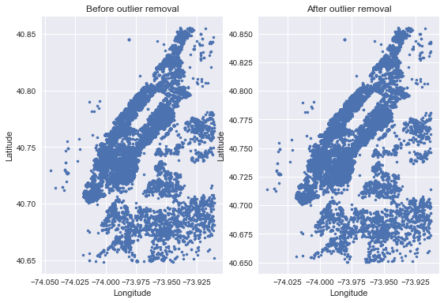
Feature Visualization // Neighborhood Outliers
Notes:
Amit

Slide 7
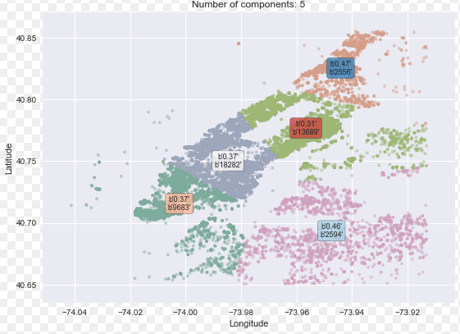
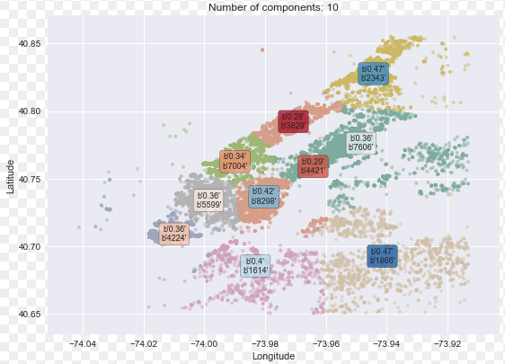
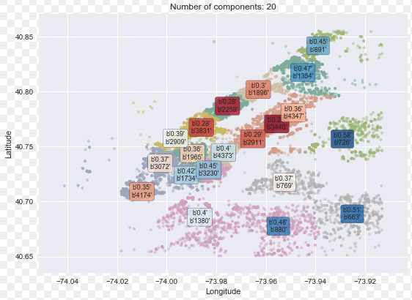
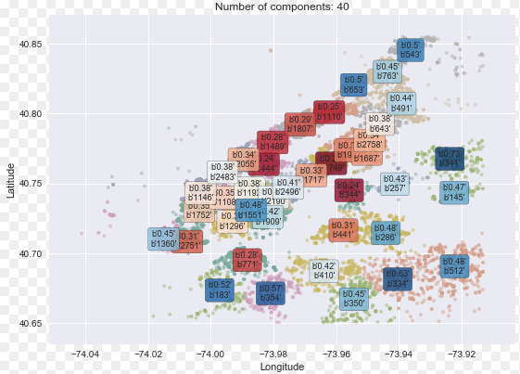
Feature Visualization // Neighborhood Clusters
Notes:
Amit

Slide 8
Models This is a classification problem
Training/Eval Features
Linear too strong for low rankings
Neighborhoods
KMeans Spatially cluster neighborhoods
Text Analysis
MultinomialNB
Linear can win if tuned, but MNB gives a strong start.
Feature Ranking
PCA Identify top features and remove correlations
Combining
Random Forest Classifier Robust ensemble method
Notes:
Amit
Can do another slide if needed
… thinking this is most important one… we should explain why do stuff way we do… but don’t think need more than just a sentance/fragment…

Slide 9
Results! Summary
Initial (based on lat/long): 0.79
Text features only: 0.75 -- BEST!
All features: 1.22
Top 3 PCA with all features: 2.22
Leaderboard best score: 0.49
We used accuracy to train instead of Kaggle scoring
Scoring
based on multi-class log loss. Therefore, you are penalized for predicting wrong interest level even if the maximum probability is the true class. A perfect model will have a score of 0.
Notes:
Steph

Slide 10

Model Post-Analysis
Surprised that initial model performed so well & all features performed much worse
Unknown factors
user demographics
photo analysis
TRY NEXT:
Deep learning
Image classification
Sequence prediction
Notes:
Steph
Surprises
What we will try next
Results reasonable or not - what real world explanations make the model good/bad
Deep learning…. Try DL next
Image classification
Sequence prediction

Slide 11
Thank You
Any Questions?

